Slide 1
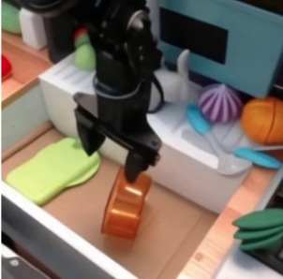
OpenVLA
BackGround & Setting
Definition of ‘Policy’:
supervised regression task of learning to map observations to actions
Setting:
Given observations and instructions, VLA is proposed to generate corresponding actions
Previous Robot Manipulation Methods:
Conventional Model-based Control: precious dynamic modeling, stable but hard to model and generalize
RL-based Control: input perception(images) output action, hard to collect data and generalize, limited in simulation environment
Imitation Learning: input and output similar to RL, but supervised with ‘correct action’ provided by human expert instead of rewarding function
How to solve the challenge of generalization?
→ Integrate the power of visual foundation model

Slide 2
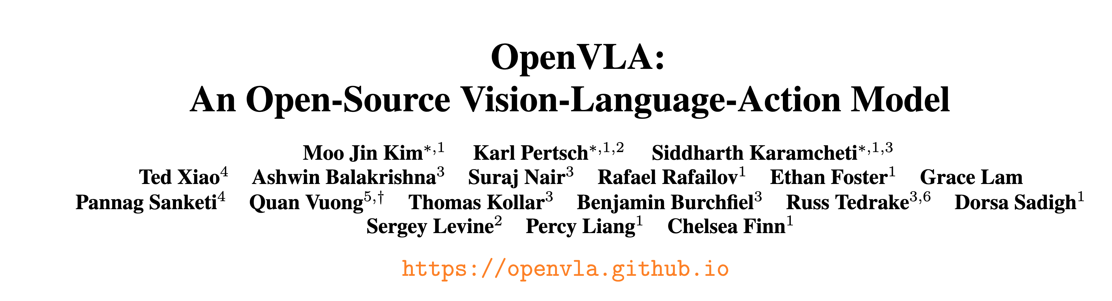
OpenVLA
BackGround

Slide 3
OpenVLA
Motivation
Using vision and language foundation model as core building block.
2. Current methods are closed.
3. Existing methods don’t provide best practice for deploying VLA to new robots and environments.

Slide 4
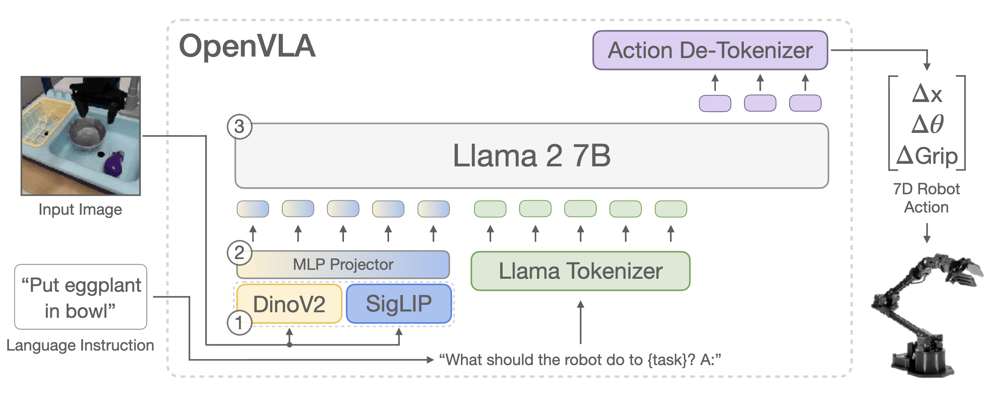
OpenVLA
Methods
Overall Pipeline
Training:
Given an input image, predict the robot action of the current frame in a next-token prediction manner, repeat at next frame.
Comments:
An image at a time ignores the modeling of time sequence, although it increases the number of data samples.
Directly predicts joint states of robot is hard without prior of robot structure
The whole model is not 3D-aware, it needs numerous dataset for convergance.

Slide 5
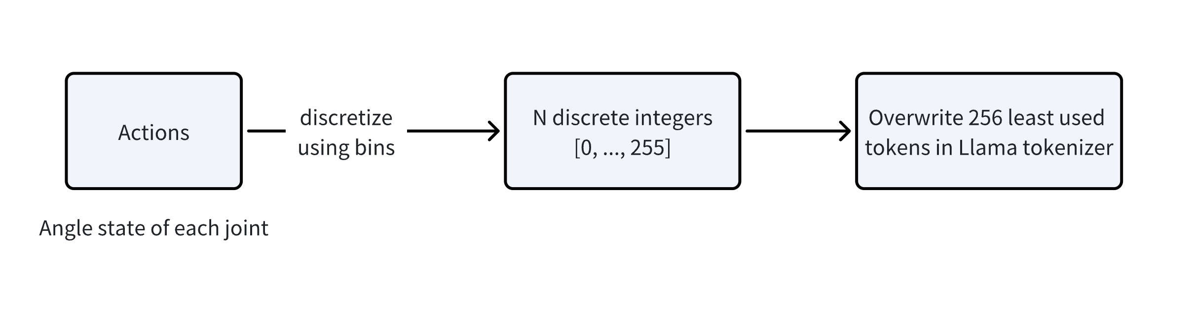
OpenVLA
Methods
How to tokenize actions?
Llama only reserves 100 special tokens newly introduced in fine-tuning
Comments
Simple and useful, but insufficient for modeling the complex action of the robot and hard to generalize to new robots.

Slide 6
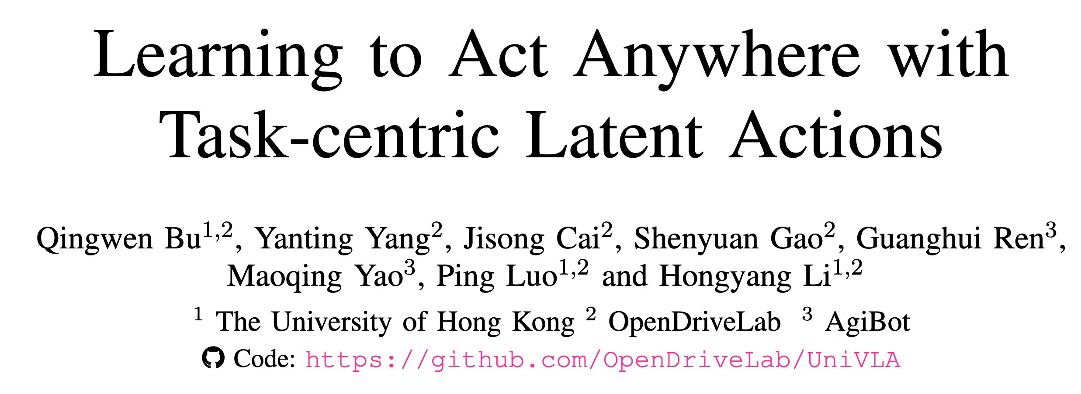
UniVLA
RSS 2025

Slide 7
UniVLA
Motivation
Challenge：
There is significant heterogeneity of action and observation spaces across different embodiments and tasks.
How to learn a unified action representation to better transfer knowledge across different embodiments and tasks?
Methods
Learn task-centric action latents
Next-token action prediction
Latents decoding

Slide 8
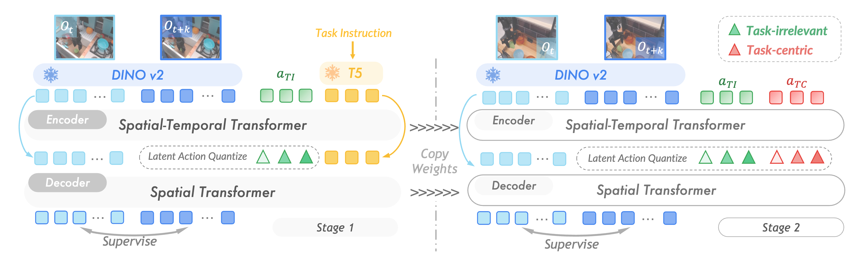
UniVLA
Methods
Task-centric Latent Action Learning：
Introduce temporal modeling with 2 images as input.
Using language feature as task-relevant information to de-couple task-irrelevant and task-centric information.
Using latent features and VQ-VAE to implicitly represent discrete generalizable robot action features aligned with vision and language features.
(trick) Using DINO feature as reconstruction loss to avoid noise and overfitting.

Slide 9
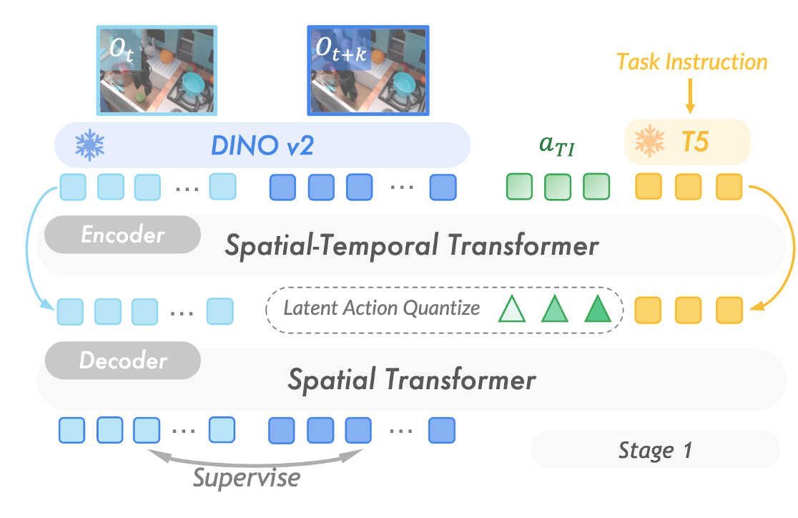
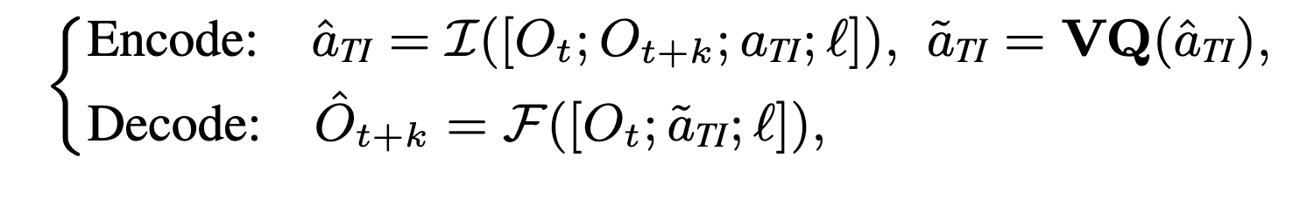
UniVLA
Methods
Task-irrelevant latent learning in a VQ-VAE (unsupervised) manner
Why VQ-VAE? Unsupervised, discrete actions
Why task-irrelevant? Using task instruction as task-relevant information, reduce size of code-book to limit the representation ability of action latent.

Slide 10
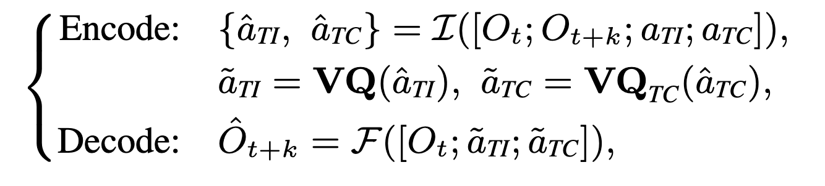
UniVLA
Methods
Task-centric latent learning by replacing language instruction

Slide 11
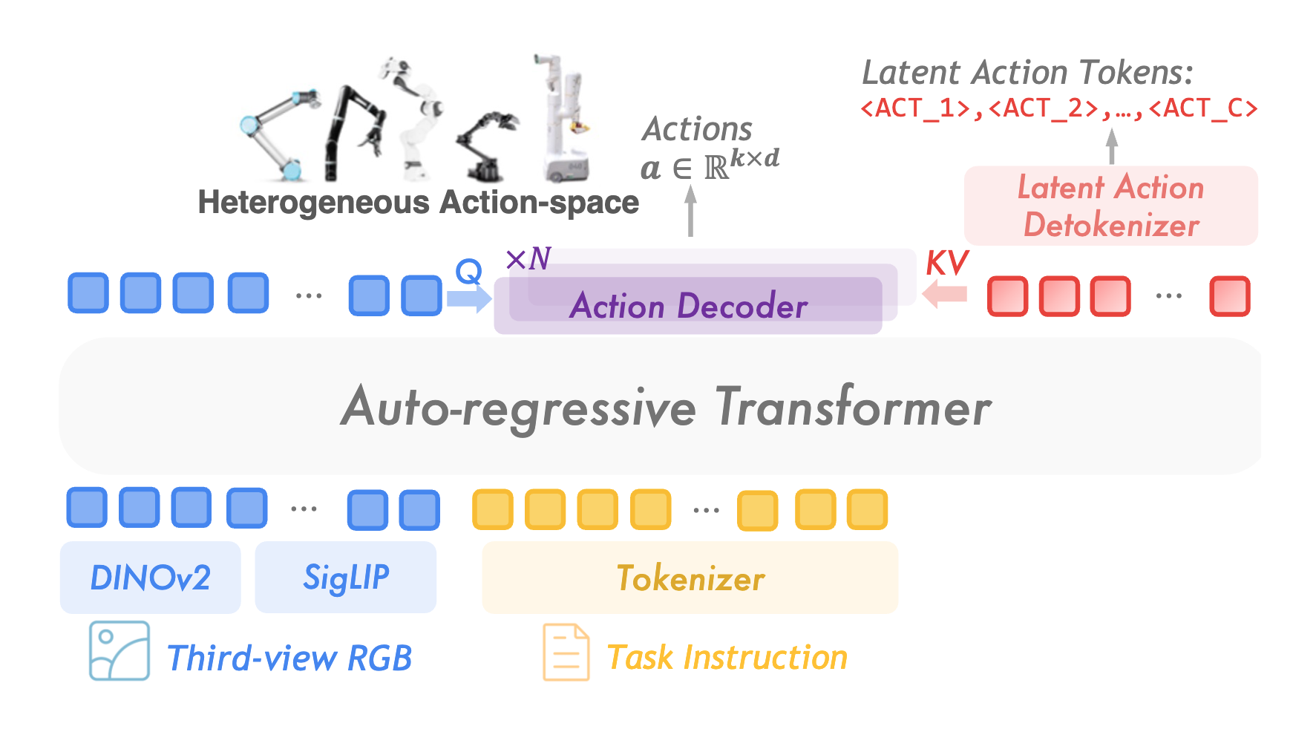
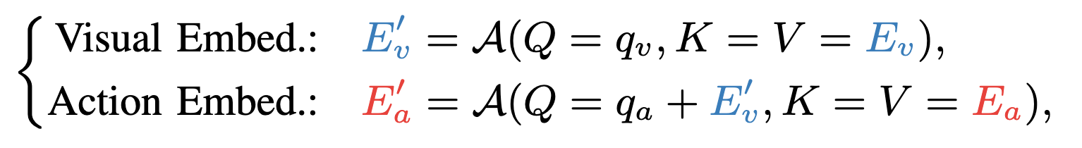
UniVLA
Methods
Next-token Prediction for Training
qa, qv: similar to class token, integrate action and vision information

Slide 12
UniVLA
Methods
Task-centric latent learning by replacing language instruction

